Slide 1





BUILD EASE

Slide 2

Our Team
AYAZ HASAN
20K-1044
Group Leader
HUSSAIN TAHIR
20K-0185
SYED ARSALAN
20K-1718

Slide 3


PROBLEM STATEMENT
The construction industry is a very complex industry that is facing some problems :
Lack of Information of Private Contractors.
Determine the contractors with bad reputation.
Lack of communication.

Slide 4
Developed Features
Client/Contractors/admin
Real Time Data
Cost Calculator

Slide 5

Data Collection
Communicate with three contractors to get the information about :
Project Type
Area Size
Project Duration
Material Usage
Labor Cost

Slide 6
Contractor Name | Email | Phone No | Address | Project Type(commercial/Residential) | Labor Cost (per sq ft) | Estimate Time | Area Size
Khursheed | Null | 0345 2202072 | Sindh Baloch Society,Gulistan-e-Jouhar | Both | 1100Rs(if material not include) | 6-8 months | 80-1000 sq yd
Syed Taha Ali | Null | 0334 2235161 | Madras Cooperative Society,Gulzar-e-hijri | Both | 1300 Rs | 7-9 months | 80-1000 sq yd
Naveed | civilnavid9@gmail.com | 0301 7541833 | Jinnah Ave, Gadap Town, Karachi, Karachi City, Sindh, Pakistan | Both | 1000-1500 Rs(depend on the project | 7-10 months | 80-1000 sq yd

Slide 7
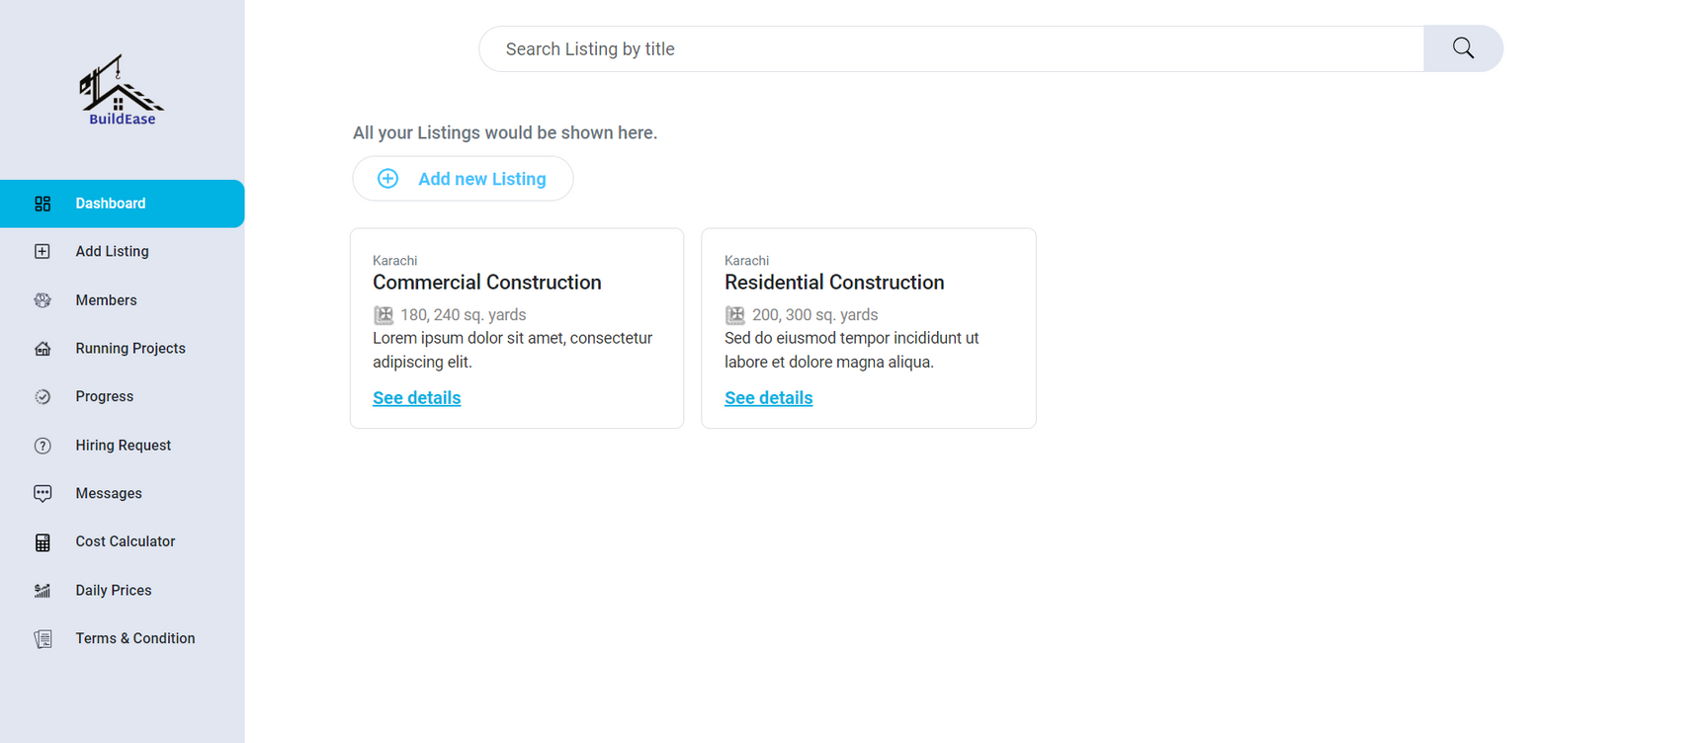
Contractor
All Contractor Listings are showed on dashboard

Slide 8
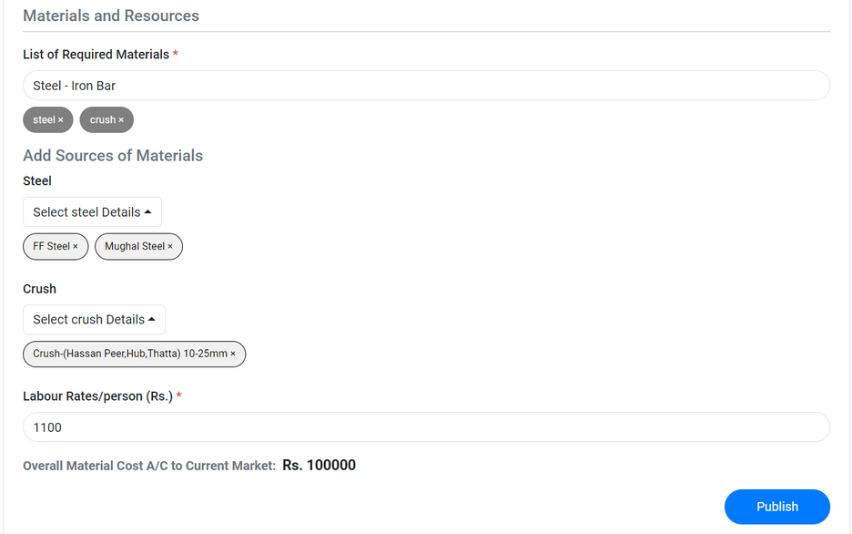
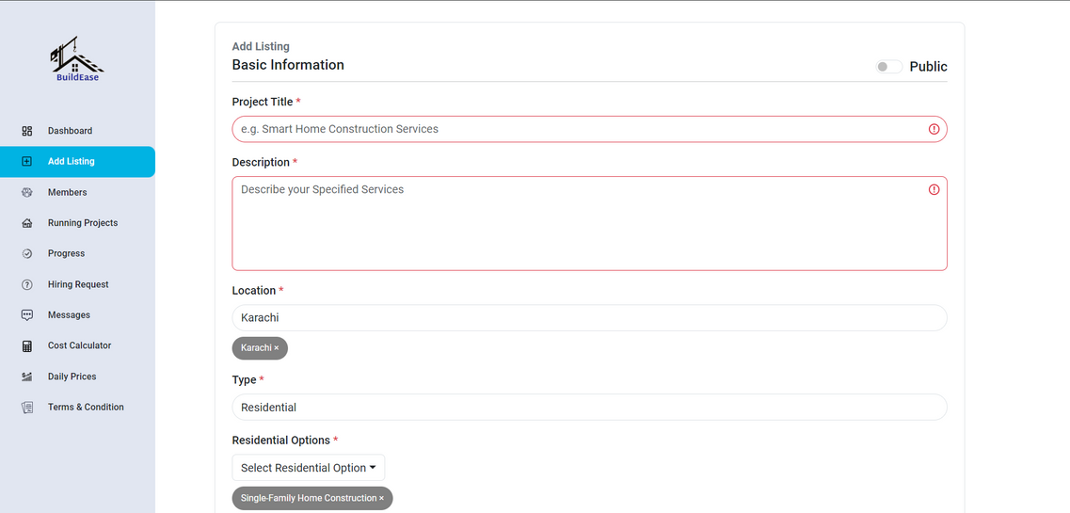
Contractor
Contractors will publish their listings by filling the form

Slide 9
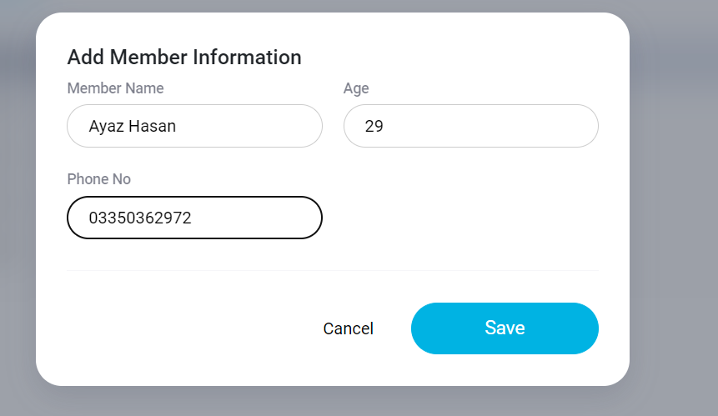
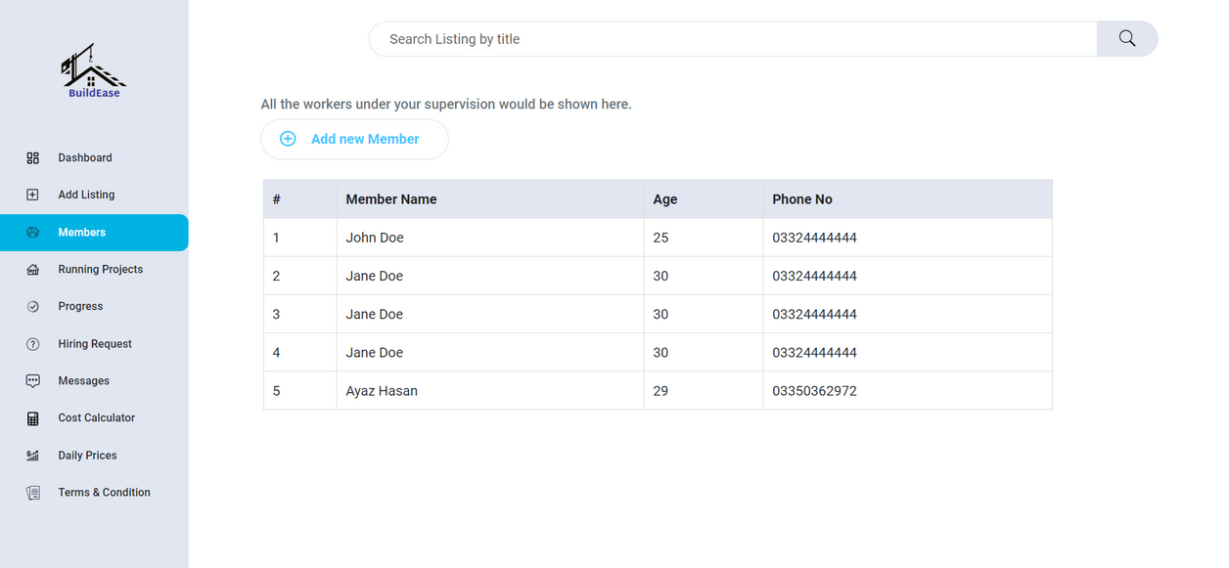
Contractor
The contractors will be able to add the members that are working on the current project by filling the form.

Slide 10
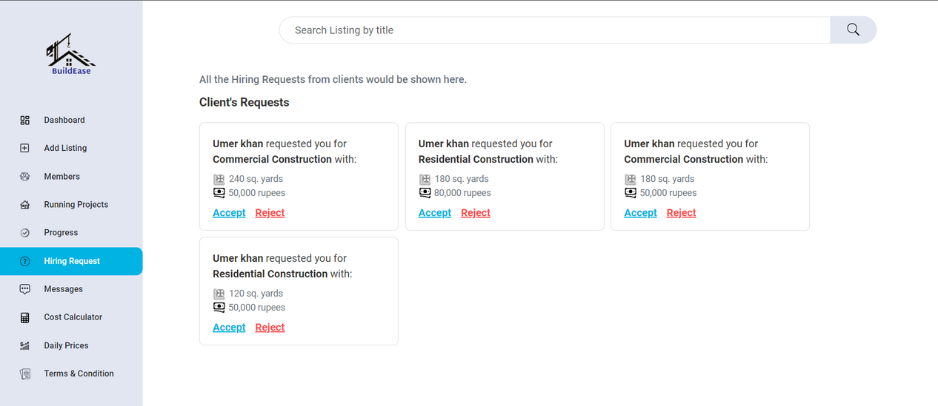
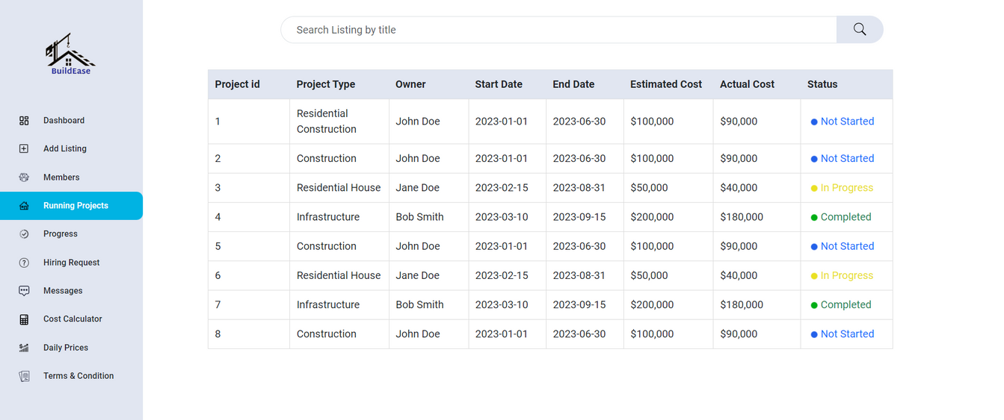
Contractor
Contractor can view the client requests and choose to accept and reject them.
Contractor can view the running projects and their status.

Slide 11
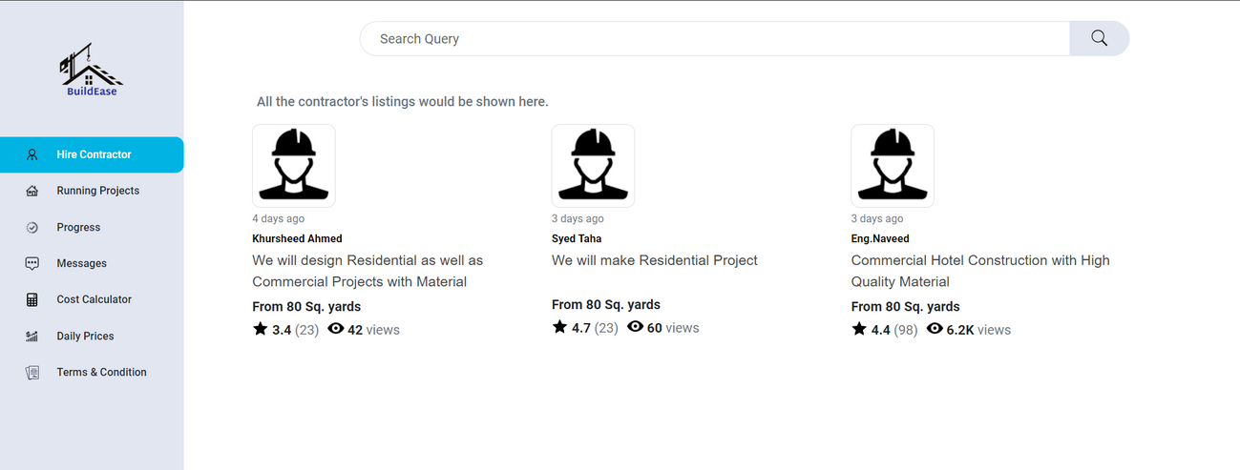
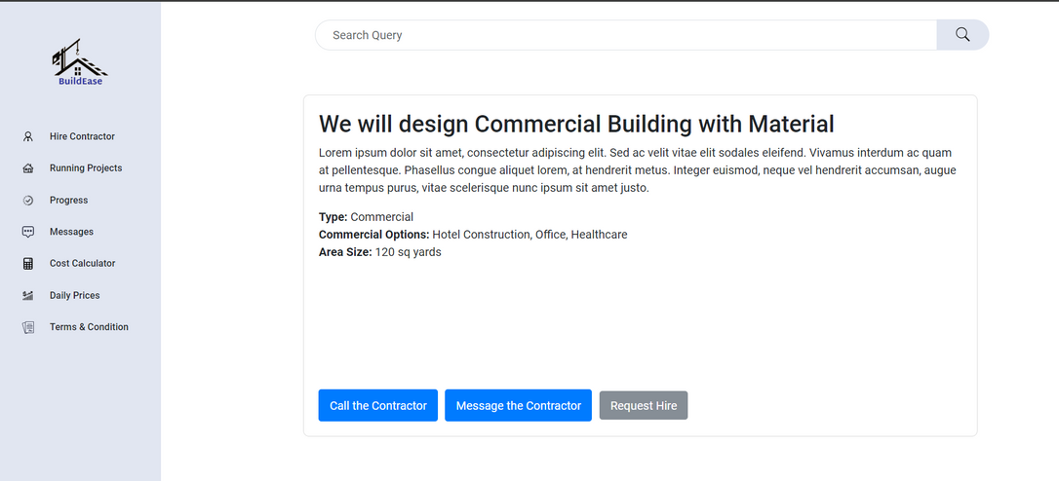
Client
The client can hire the contractor by viewing the cards, based on their ratings and views by clicking on the card another page will appear with the contractor info and the options to message, call and send the hiring request.

Slide 12
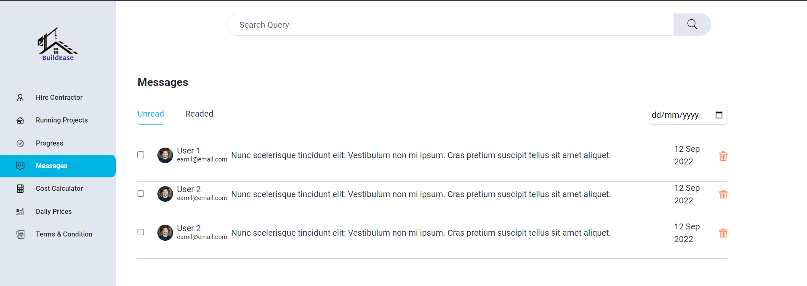
Client
The client will be able receive the messages, delete the messages ,reply to messages from the contractors clients can receive and send images.

Slide 13
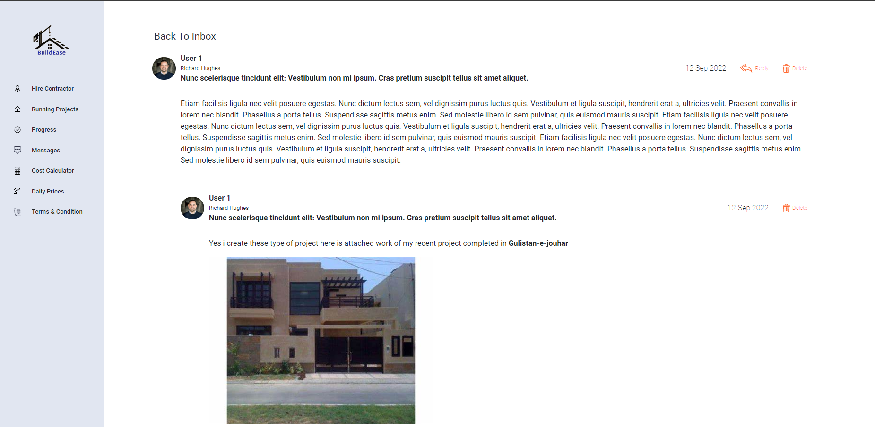
Client

Slide 14
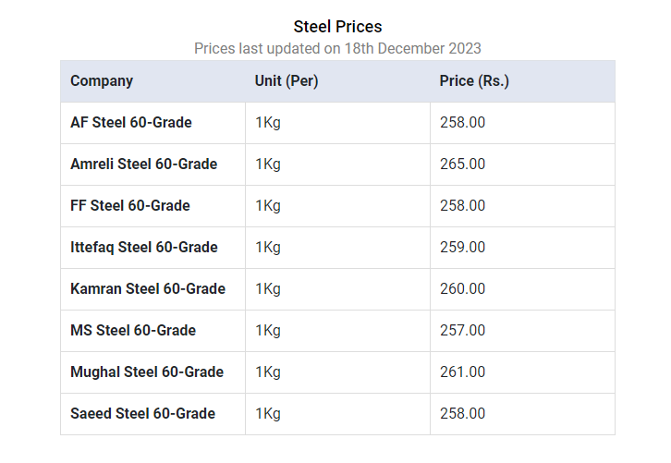
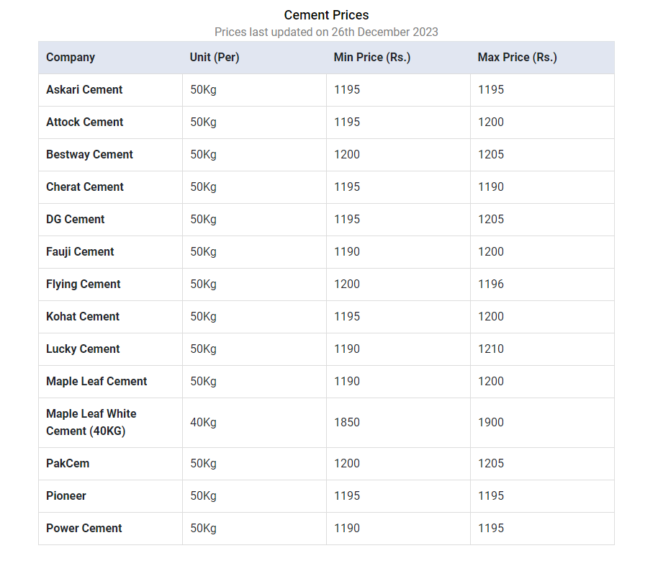
Real Time Data
The real time data is taken shown from 3 to 4 different websites that shows the material rates from different companies using web scrapping in python. The data is updated recently

Slide 15
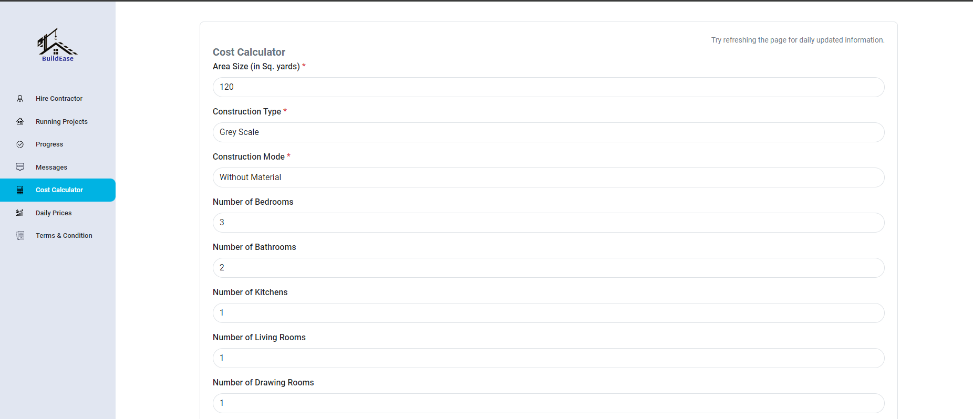
Cost Calculator
The clients can calculate the costs by using the cost calculator, the information has to be entered the total estimated cost will be displayed after filling the form.

Slide 16
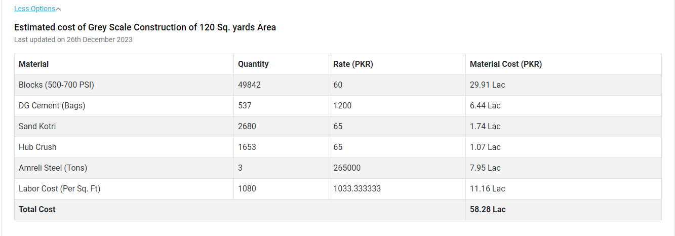
Cost Calculator
The clients can calculate the costs by using the cost calculator, the information has to be entered the total estimated cost will be displayed after filling the form.

Slide 17
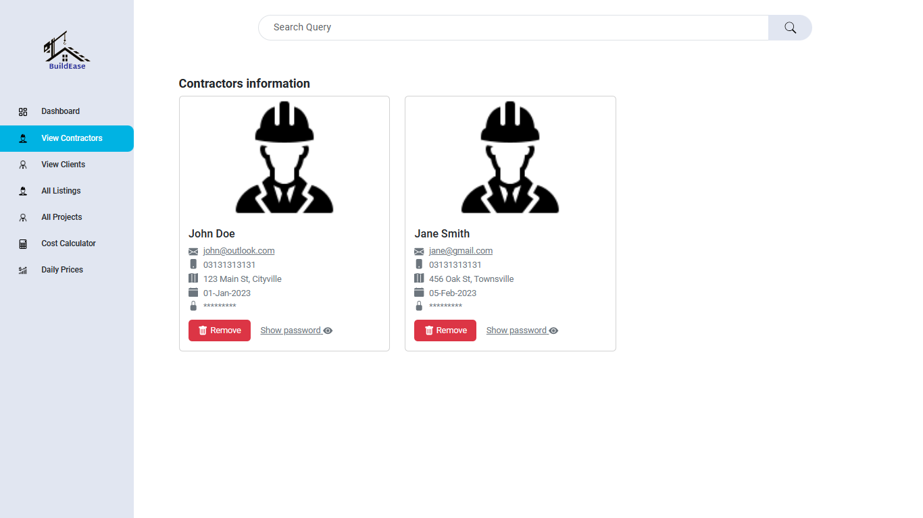
Admin
The admin page will show all the listings , contractors and the clients. the admin will be able to manage and approve the listings

Slide 18
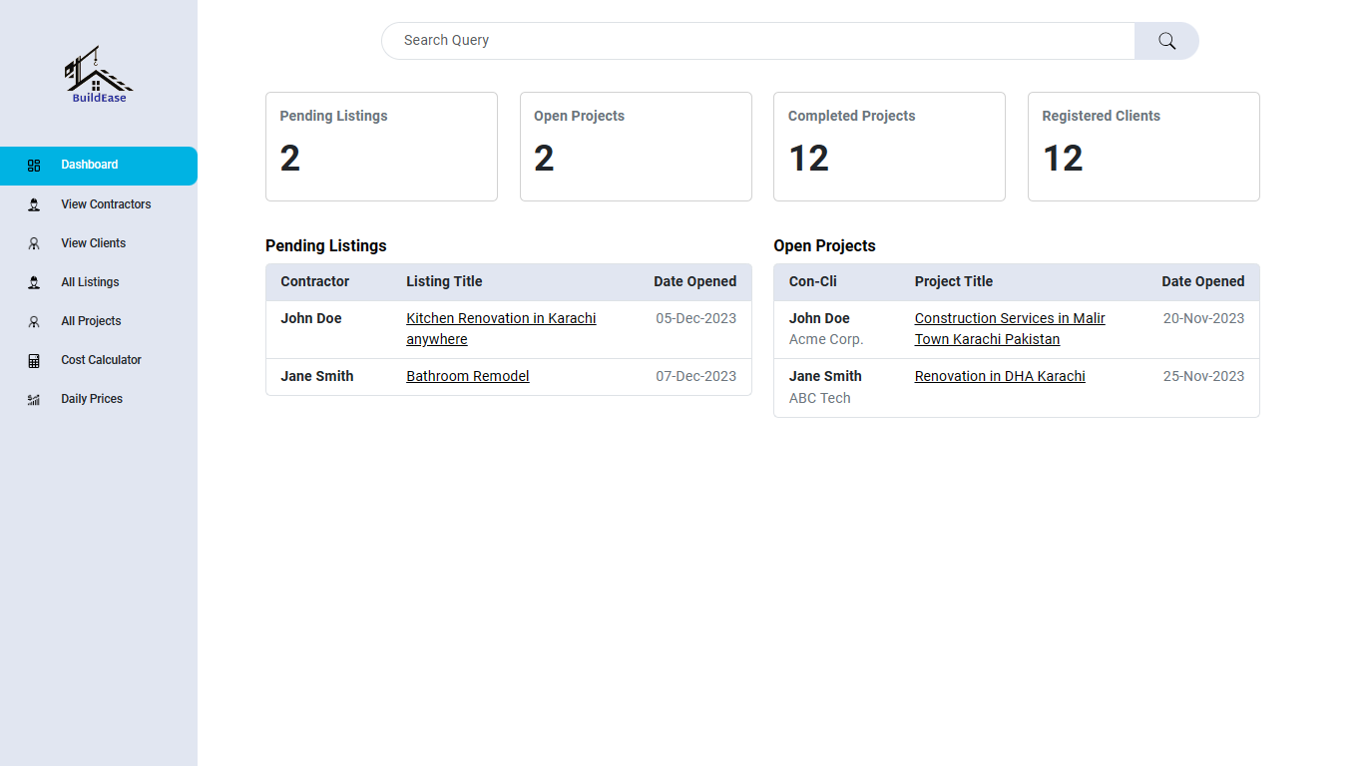
Admin
The admin can view the Listings and projects and their status.

Slide 19
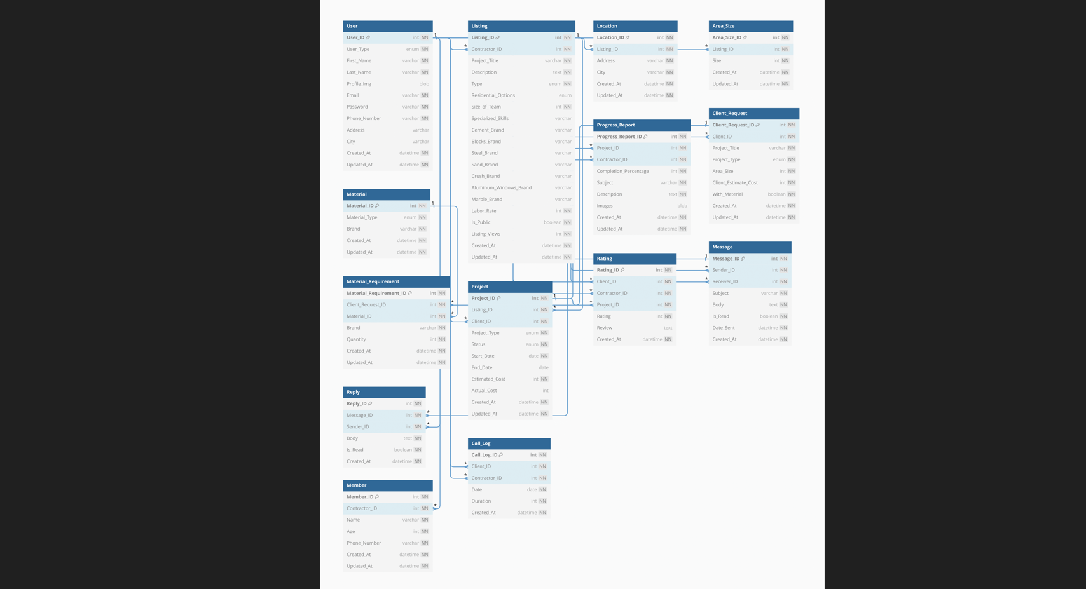
ERD

Slide 20

Work Progress

Slide 21




Libraries Used

Slide 22

Project Timeline
MONTH 1
MONTH 2
MONTH 3
MONTH 4
MONTH 5
MONTH 6
MONTH 7
MONTH 8
UI DESIGN
CODING
TESTING
INTEGRATION
SYSTEM ANALYSIS
DATABASE DESIGN
PROJECT FINALIZATION
Gathering Software Resources and Information

Slide 23


THANK YOU
For watching this presentation
K201044@NU.EDU.PK
FAST NUCES, KARACHI

